Slide 1
Observability in Cloud Native Apps
July, 2019

Slide 2
Agenda
OBSERVABILITY
What is Observability
Why is it Important
Where is the Gap
Tools Available
Challenges

Slide 3
About Me

Slide 4
DISCLAIMER
NO SILVER BULLET - EVOLVING FIELD

Slide 5
Rapidly Changing times
AGILE Development
Cross-functional teams
High Pace of Innovation
Explosion of services
Higher “Always On” requirements
Waterfall Model
Disconnected teams
Slow Pace of Innovation
Less traffic
Constrained environments
Lower “Always On” requirements
2-Tier Monoliths
3-Tier Monoliths
N-Tier Monoliths
Micro-services
Serverless

Slide 6
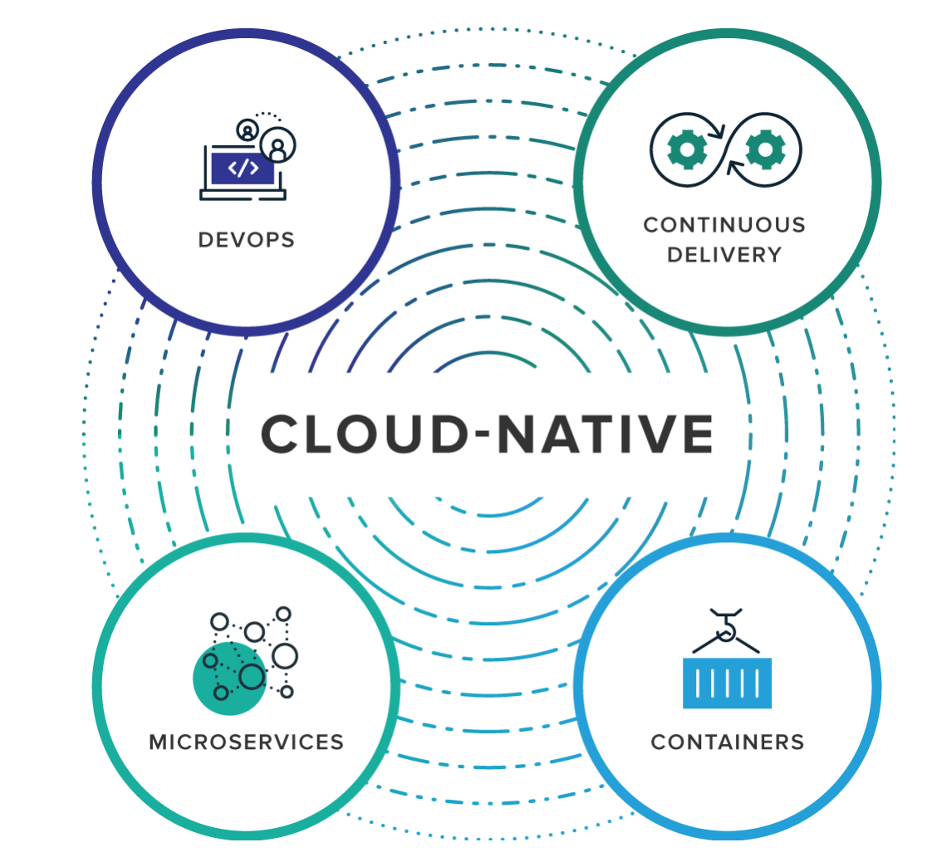
Modern application development
GOAL : Build , Ship , Scale Faster and Safer
Simplify Environments Management – Containerization
Increase business agility - Microservices*
Favor Change without compromising stability - Continuous Delivery
Enable Culture for Continuous improvement , Empower Team to innovate - DevOps

Slide 7
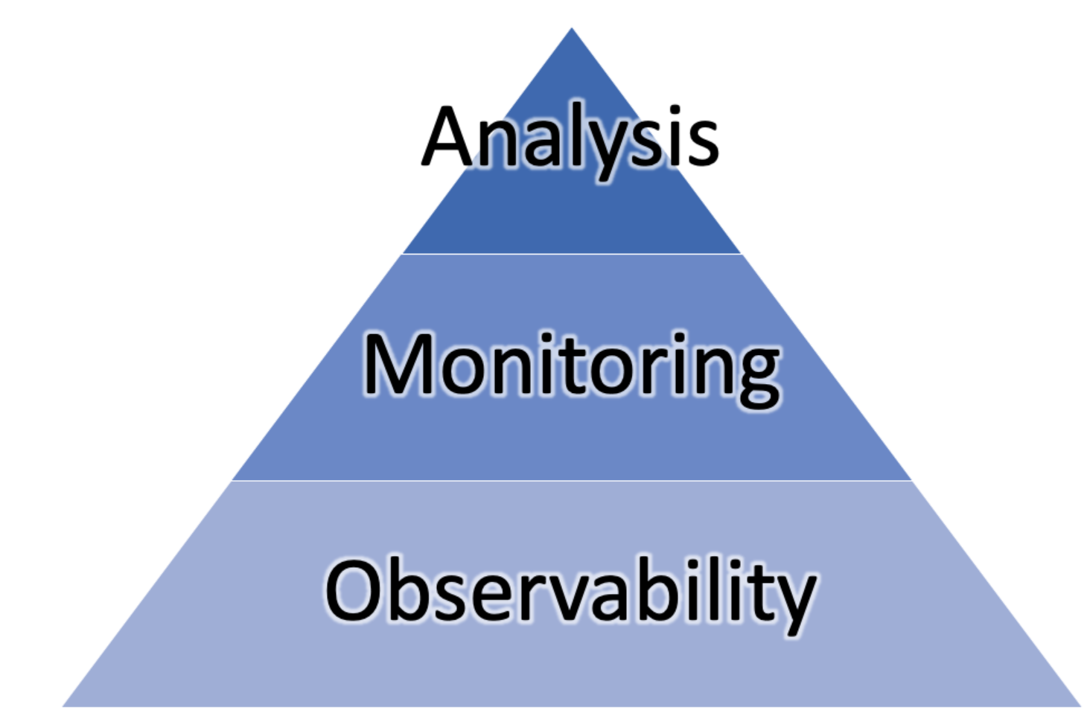
Observability - WHAT
In control theory, observability is a measure of how well internal states of a system can be inferred from knowledge of its external outputs
Simply put, it’s the care taken to enable ease in operation.
VS
Designed for observability , essential monitors , sensors helping to infer internal state
Proactive
Ask Smart question , get indicators
Hex, tcp, heap,thread – all kind of dumps
Reactive
Find answers / smoking gun !

Slide 8
Observability - why
ASPECT | OLD | NEW
APPS
CULTURE
Monolith
Microservices
NO ESCAPE
YOU BUILT IT. YOU RUN IT !!

Slide 9
Levels of observability
APP
Include All levels
Include Contextual Information
Gather understanding of monitors
Correlate information
INFRA (HW)
NETWORK

Slide 10
PILLARS OF OBSERVABILITY
Structured
Context (mdc)
Collector (fluentd)
Correlate (traceid)
Generate alerts
Generate metrics
Resource usage (threads,connection,queue depths etc)
Add Dimensions for filtering
expose percentiles
Also add business focused metrics
Add Context
Logs
Metrics
Tracing
Visualization
Cheaper
Easier to construct patterns
Sampled
Hard to trace request journey
Generalized /agg info
Cheaper
Easier to construct patterns
Sampled
easier to trace request journey
Limited Info
Monitor resource usage
Monitor percentiles
Most Rich source
Costly
Harder to construct patterns
Highest granularity

Slide 11
Instrumentation options
CUSTOM METRICS (IN CODE)
For known unknowns (connection counts, queue depths etc.)
Business focused metrics
All occurrences are reported (although aggregated)
BYTE CODE INSTRUMENTATION (AGENTS)
Code paths are sampled
For unknown unknowns
SIDE CAR PROXY (MICROSERVICES SERVICEMESH)
Less work required to enable monitoring/tracing
Provides component level traceability
Builds service graphs

Slide 12
OBSERVABILITY ARCHITECTURE
APP
collector
observability
APP
APP
collector

Slide 13
OBSERVABILITY TOOLS - LOGS

Slide 14
Observability tools - MICROMETER
GAUGE
A gauge is a handle to get the current value. Typical examples for gauges would be the size of a collection or map or number of threads in a running state.
COUNTER
Counters report a single metric, a count. The Counter interface allows you to increment by a fixed amount, which must be positive.
TIMER
Timers are intended for measuring short-duration latencies, and the frequency of such events. The micrometer-core modules contains a @Timed annotation that can be used by frameworks to add timing support to either specific types of methods such as those serving web request endpoints or generally to all methods.
HISTOGRAM
accumulates values to an underlying histogram and ships a predetermined set of buckets to the monitoring system., useful for percentile calculation on the server (e.g. Prometheus)
Gauge gauge = Gauge
.builder("gauge", myObj, myObj::gaugeValue)
.description("a description of what this gauge does") .tags("region", "test") // optional
.register(registry)
Counter counter = registry.counter("counter");
Counter.increment(1);
Timer.Sample sample = Timer.start(registry); sample.stop(registry.timer("my.timer", "response", response.status()));
Timer.builder("my.timer") .publishPercentiles(0.5, 0.95) // median and 95th percentile .publishPercentileHistogram() .sla(Duration.ofMillis(100)) .minimumExpectedValue(Duration.ofMillis(1)) .maximumExpectedValue(Duration.ofSeconds(10))

Slide 15
OBSERVABILITY TOOLS - tracing

Slide 16
DEMO

Slide 17
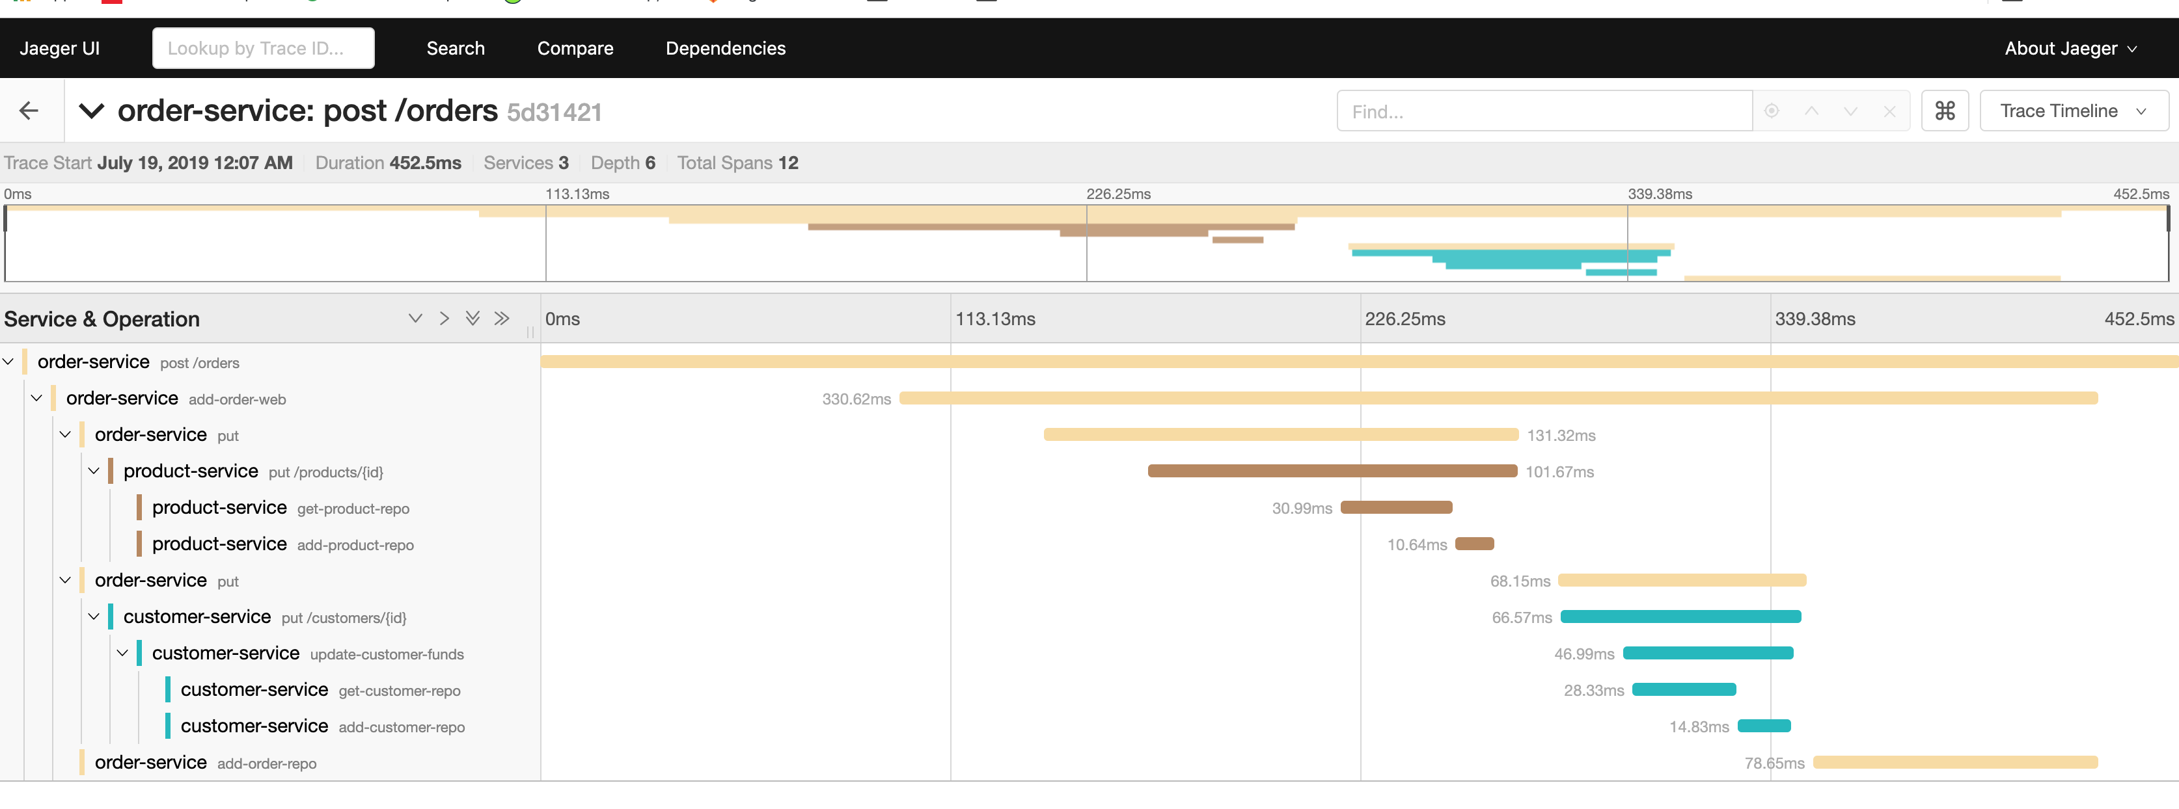
Dashboards - tracing

Slide 18
Questions

Slide 19
THANK YOU

